Slide 1
Tools and Terms of Digital Natives
Rob Honomichl
Instructor – College of Business and Information Systems
Dakota State University

Slide 2
What the C is the cloud?
We use to call this the internet, however this has become a buzz word. I like to call it someone else stores you stuff on their stuff instead of you storing it on your stuff.
Dropbox
Google Docs
Office Online
SkyDrive
Well and just about anything web 2.0

Slide 3
What the F is FourSquare?
Not for the playground
How is it being used in technology, business, and marketing?
Why do we care about telling people where we are or where we go?

Slide 4
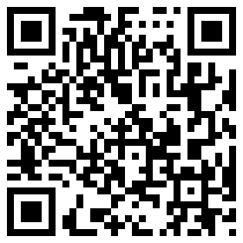
What the Q is a QR Code?
You see them everywhere.
How can my students use them?
How do I make them?
How do I use them?
http://kaywa.com

Slide 5
We Are Mobile…Let’s Embrace It
AirCards
iPads
Laptops/Netbooks
Smartphones
iPods
Do we fight the change of personal portable technology or do we embrace it and find a way to use it in the classroom?

